Slide 1

Twitter Sentiment Classification
Nick Gigliotti

Slide 2
Business Problem
Create an accurate predictive model that can classify novel tweets as expressing positive, negative, or neutral sentiment.
Find out what people are saying about Apple and Apple products at South by Southwest, 2011.
Make some PR recommendations for the period immediately following the event.

Slide 3

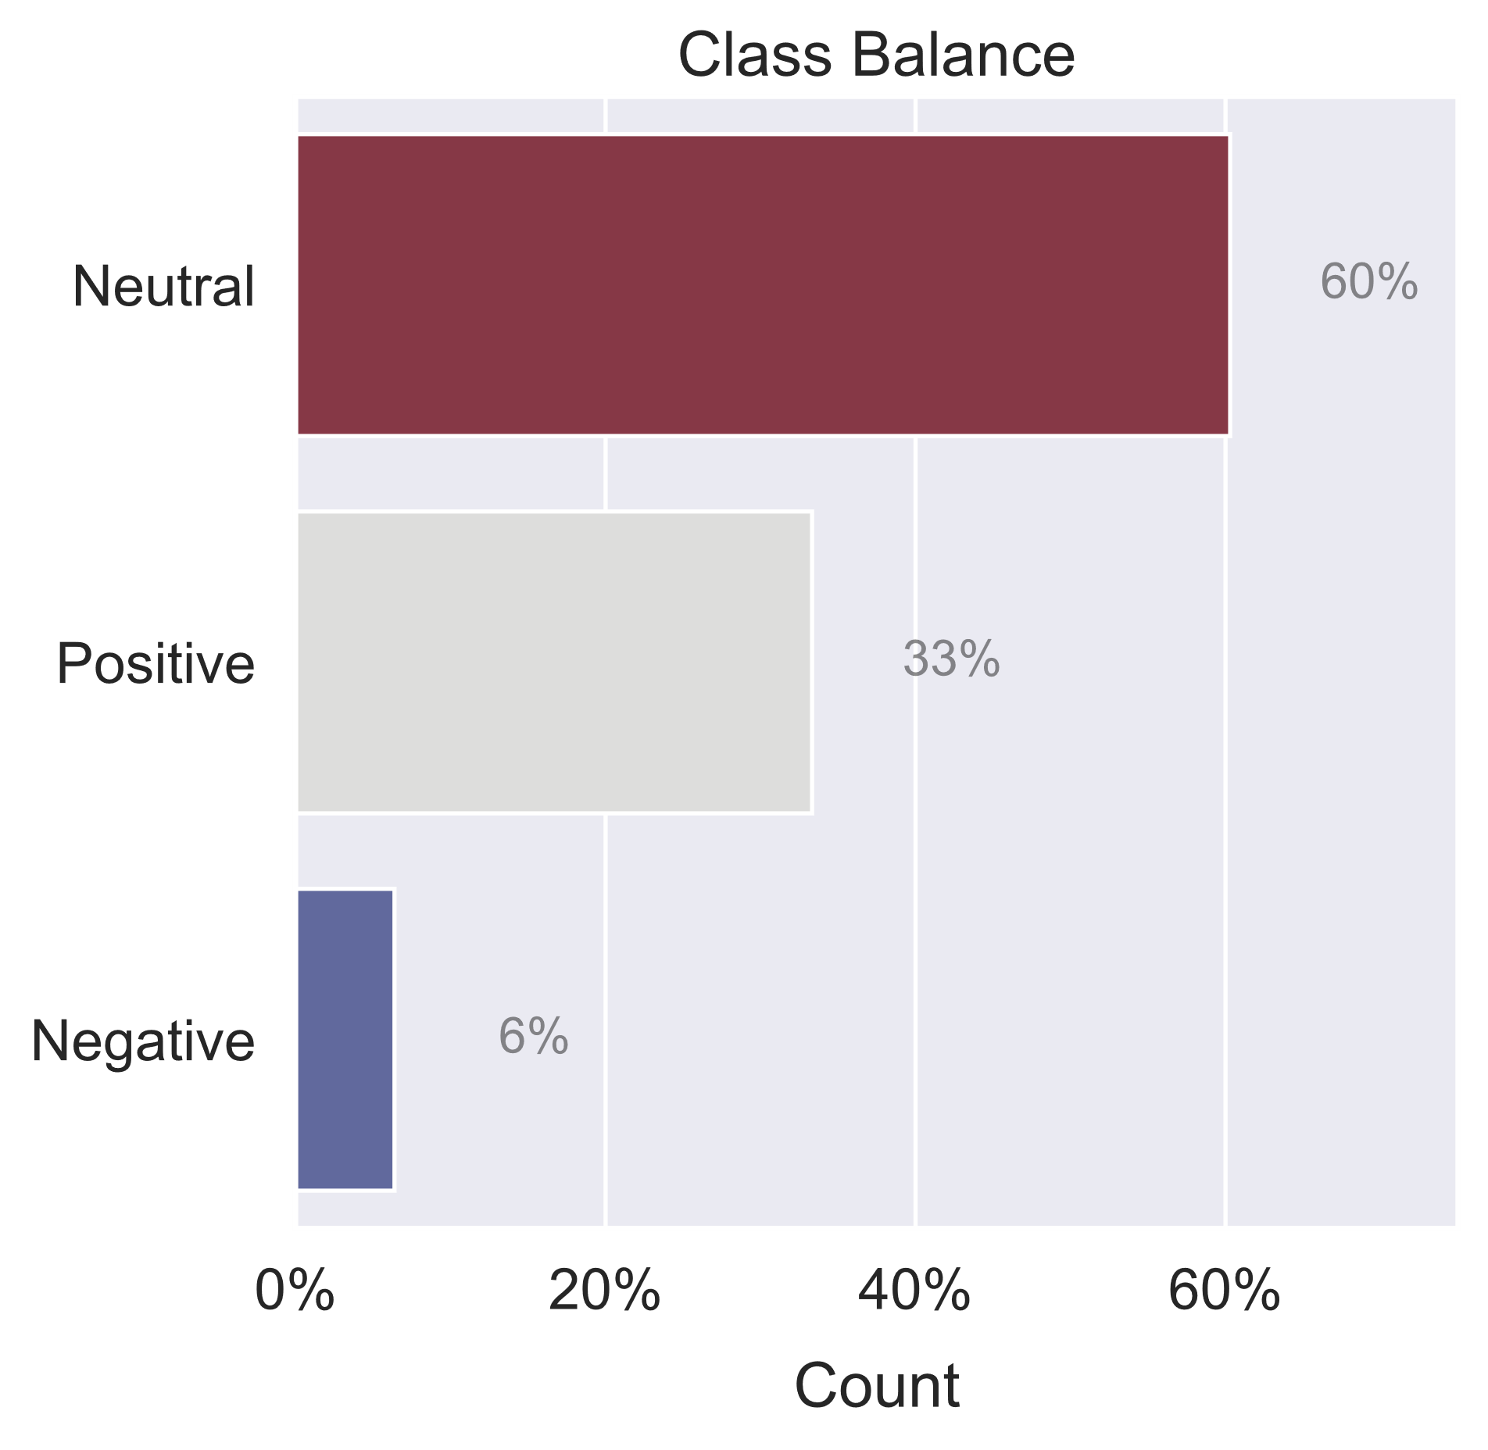
Dataset
Tweets related to South by Southwest, 2011
Annual conference and arts festival
Austin, TX
Major site for iPad 2 Launch
Crowdsourced sentiment labels
~9k tweets: just text and labels
Tweets are labeled with Positive, Negative, Neutral, or Uncertain
Tweets are labeled with brands and products related to the sentiment
Sparse ‘Negative’ class

Slide 4

Methods
Iterative Process
Logistic Regression
Preprocessing
Lowercase
Porter stem
TF*IDF Vectorization
Term Frequency * Inverse Document Frequency
Balances term count with corpus-wide rarity
A high score means high term importance
VADER Analysis
Valence Aware Dictionary and Sentiment Reasoner
Rule-based sentiment analysis tool
Gives each tweet a Positive, Negative, Neutral, and Compound polarity score
Mark negation
Naïve Bayes
Linear SVM
Performed better than:
Many parameter sweeps
Careful attention to detail

Slide 5
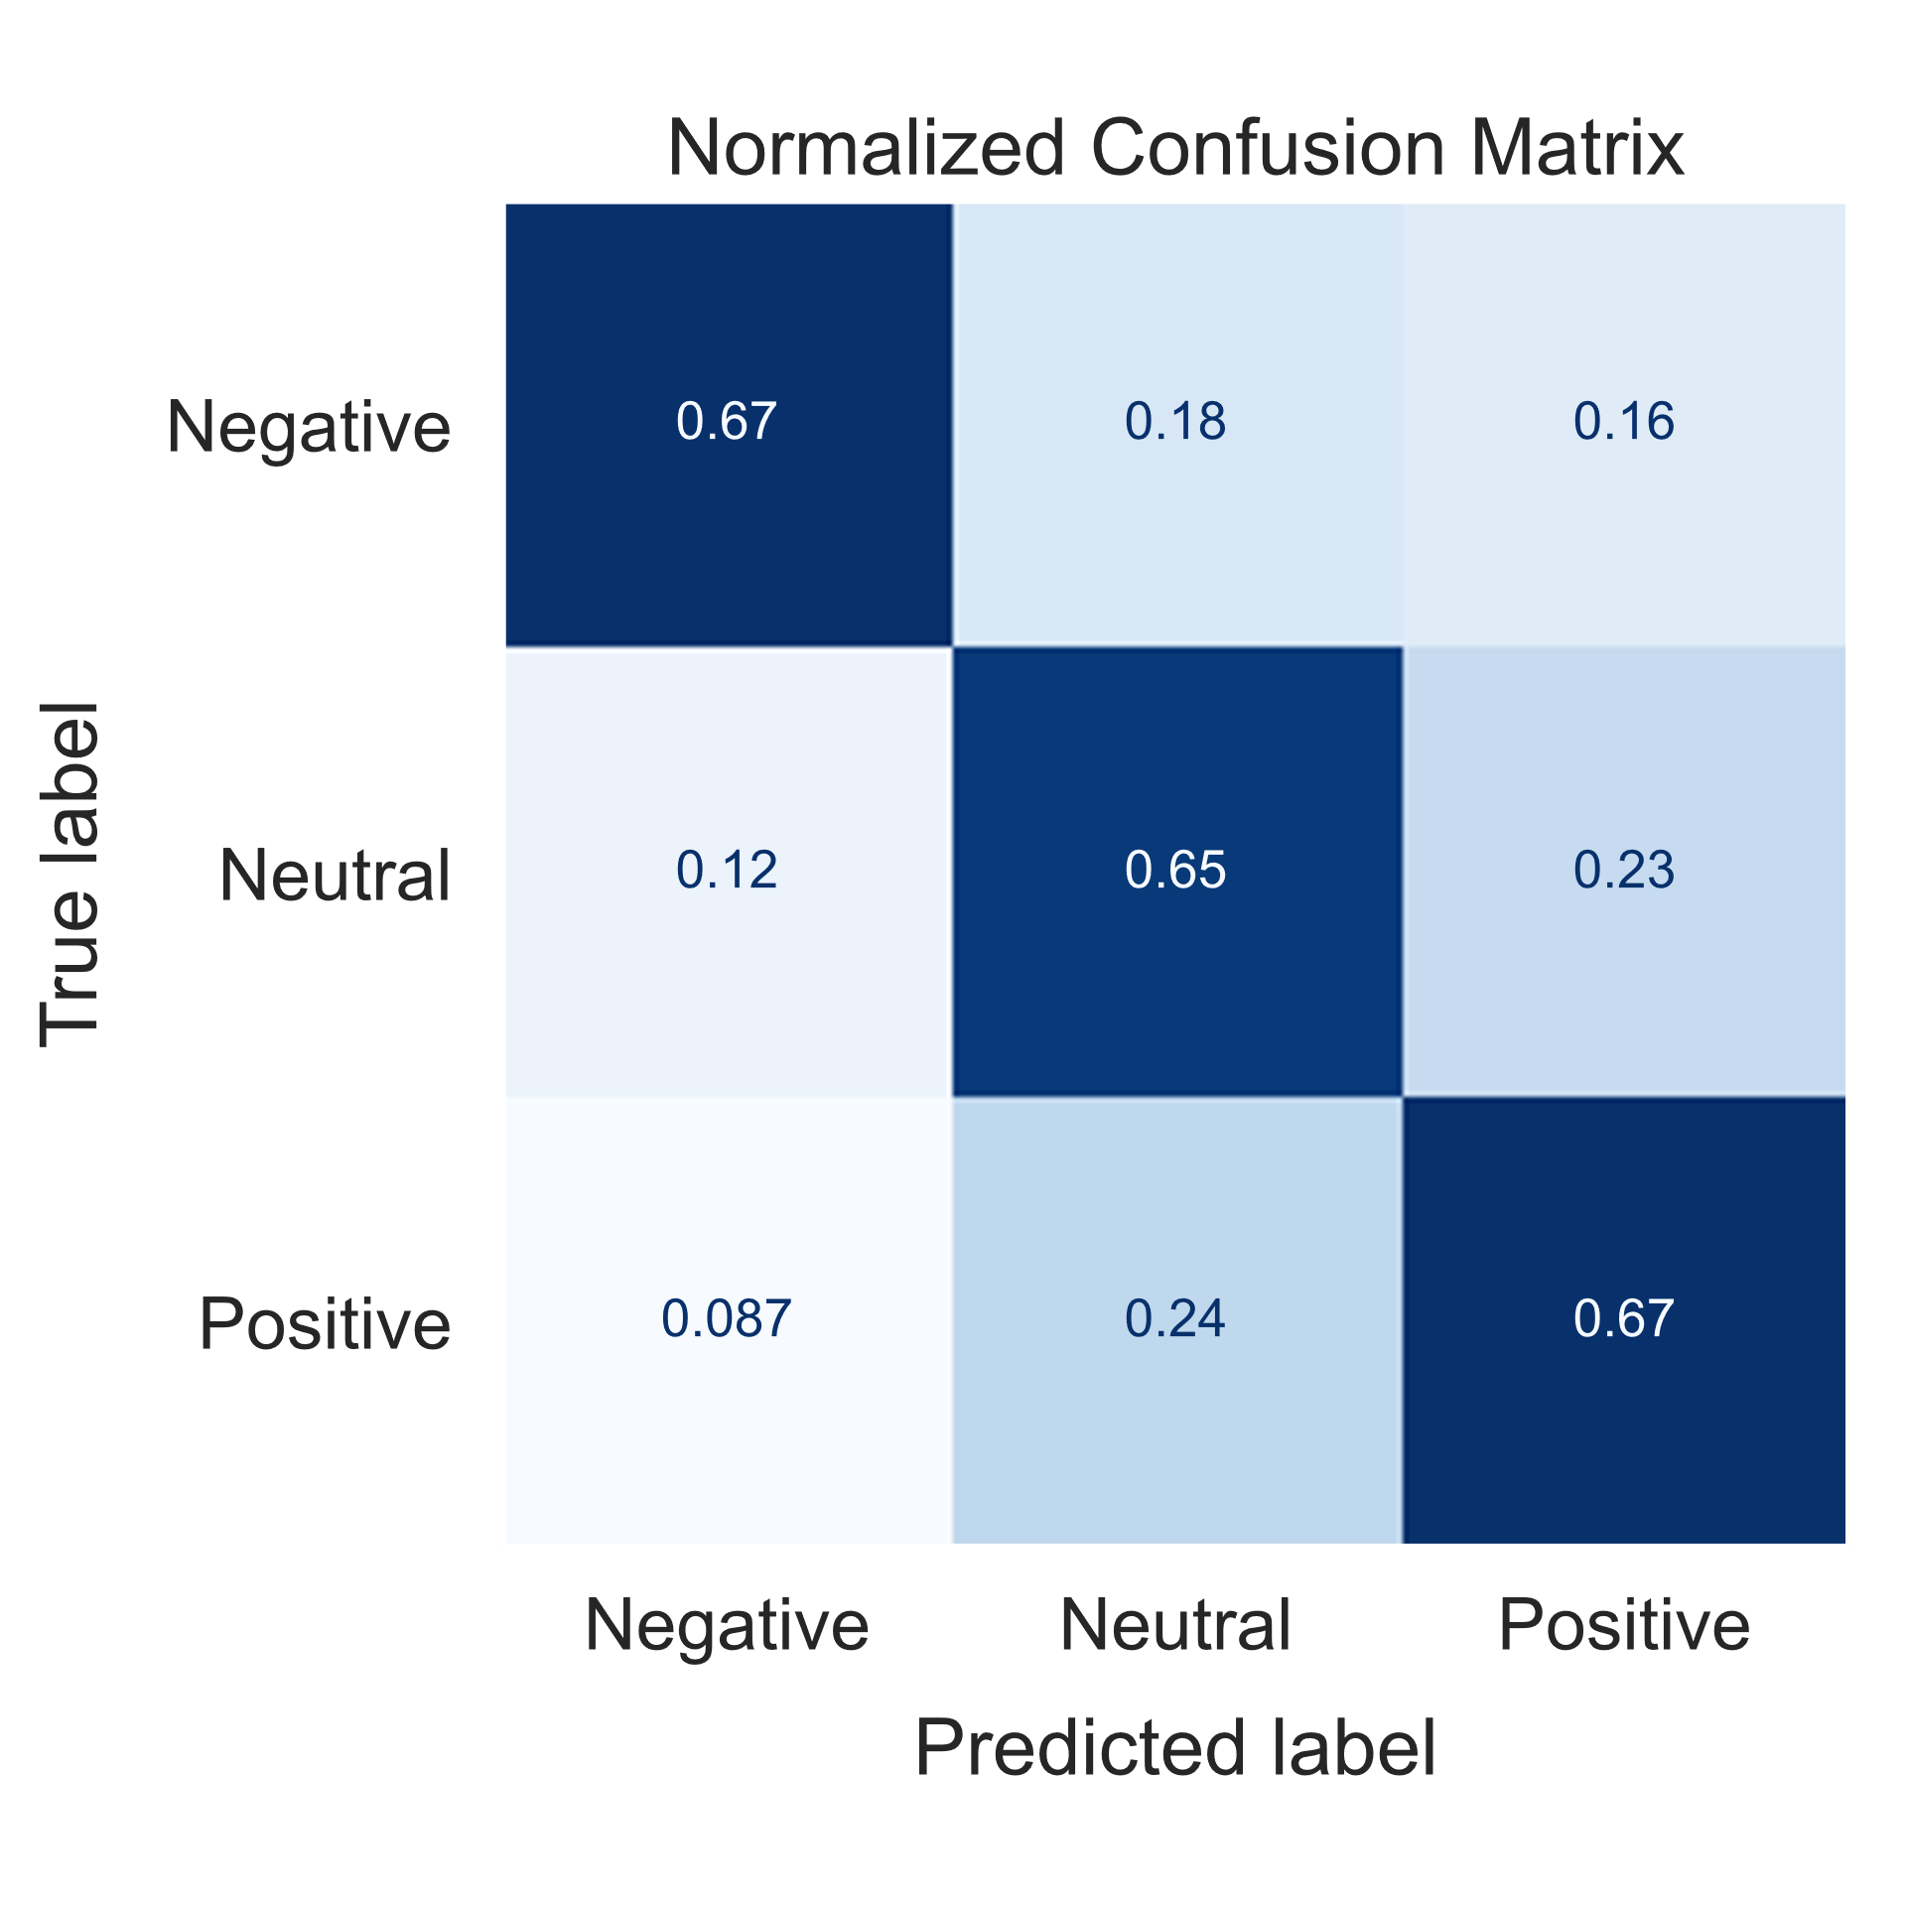
Model
Balanced Accuracy
Score: 0.66
Equivalent to average recall
High Negative Recall
Negative Support: 6% of samples
Positive Support: 33% of samples
Sacrifices Neutral Recall
Most common and least important
Not a subject of research
Equivalent to average of diagonal
Equal Positive and Negative recall
Neutral Support: 60% of samples

Slide 6

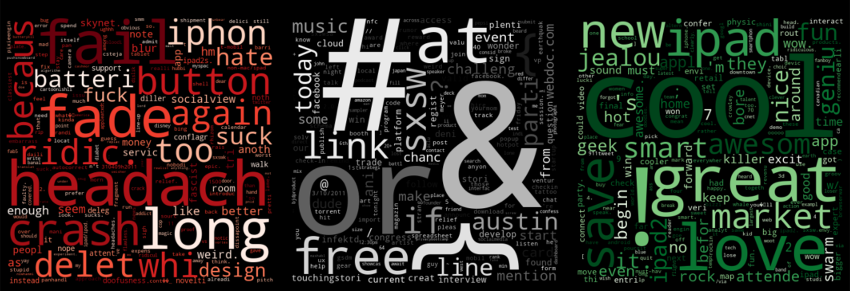
Most Important Features
TF*IDF Coefficient Wordclouds
Top features for prediction are TF*IDF words.
‘batteri’ and ‘iphon’ are highly associated with Negative.
Complaints about iPhone battery life
‘ipad’ is highly associated with Positive.
Punctuation and common terms like ‘austin’ and ‘sxsw’ are associated with Neutral.

Slide 7
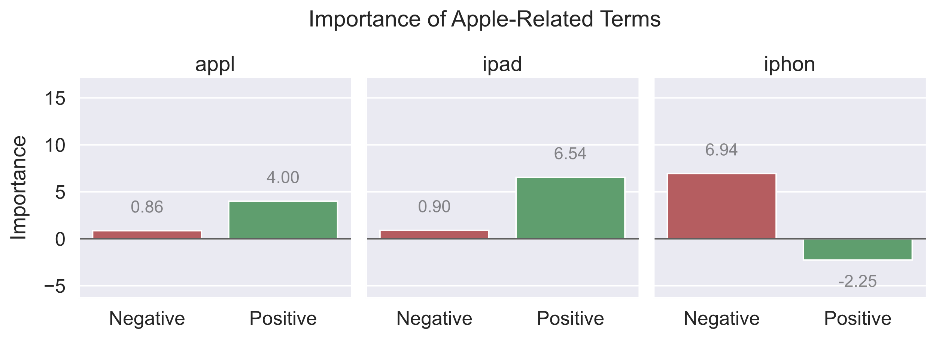
Apple-Related Coefficients
Observations:
‘iphon’ is associated with Negative
‘ipad’ is associated with Positive
‘apple’ is associated with Positive
People are much more excited about iPads than iPhones.
Tweets from iPad 2 launch.

Slide 8
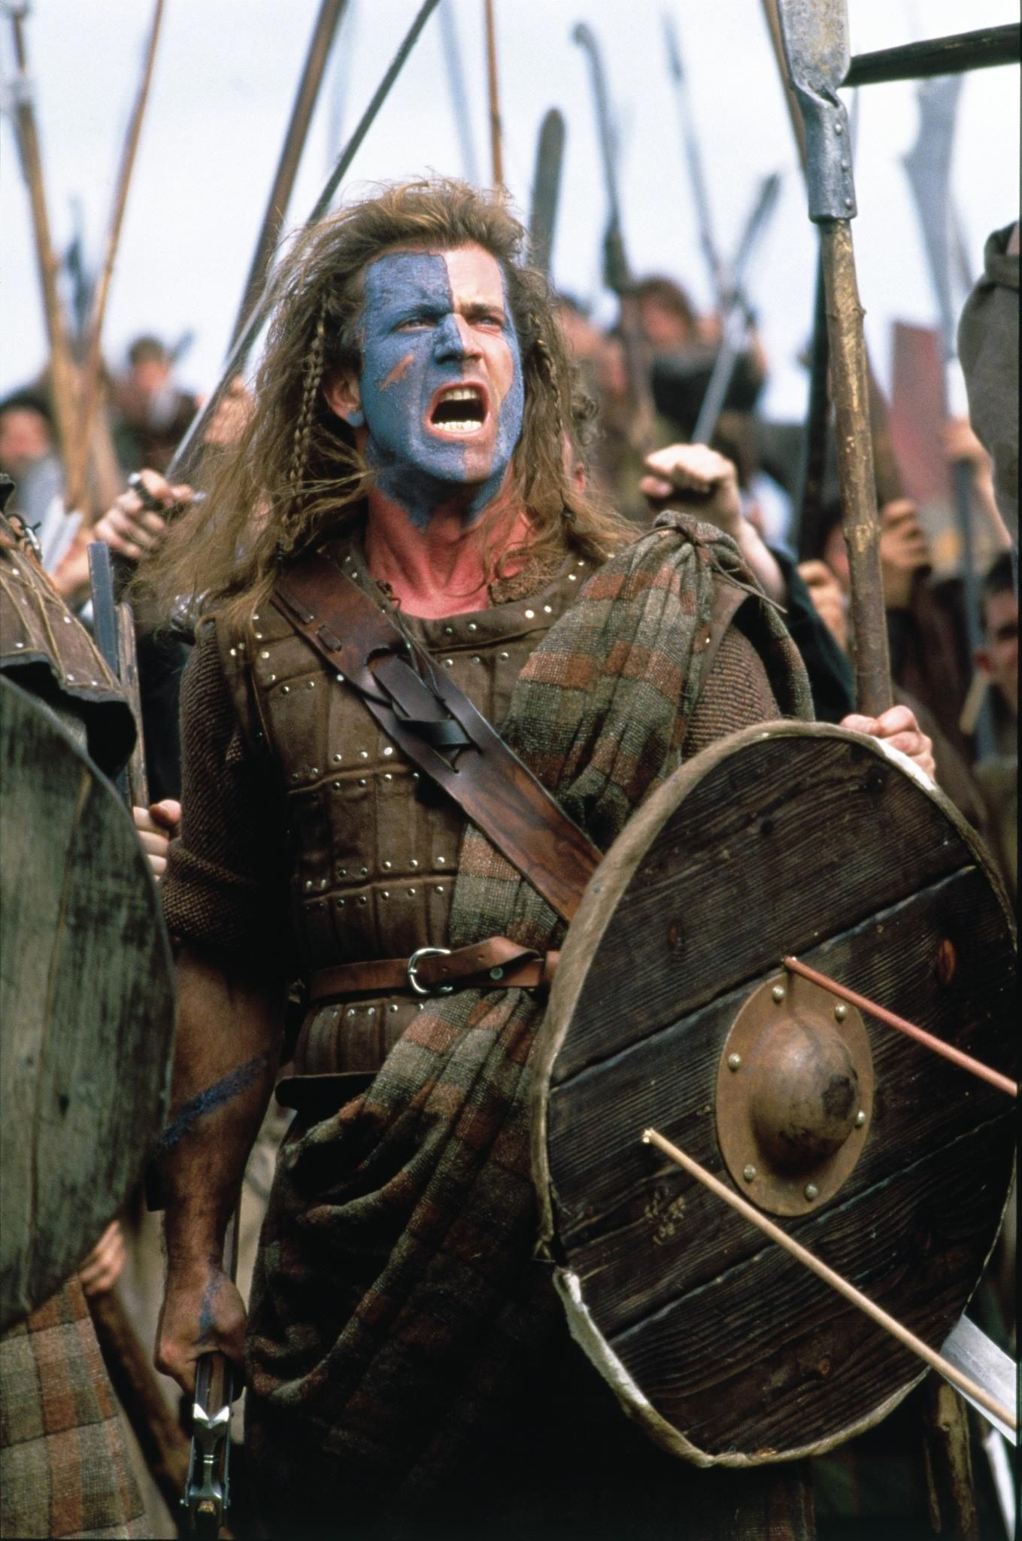
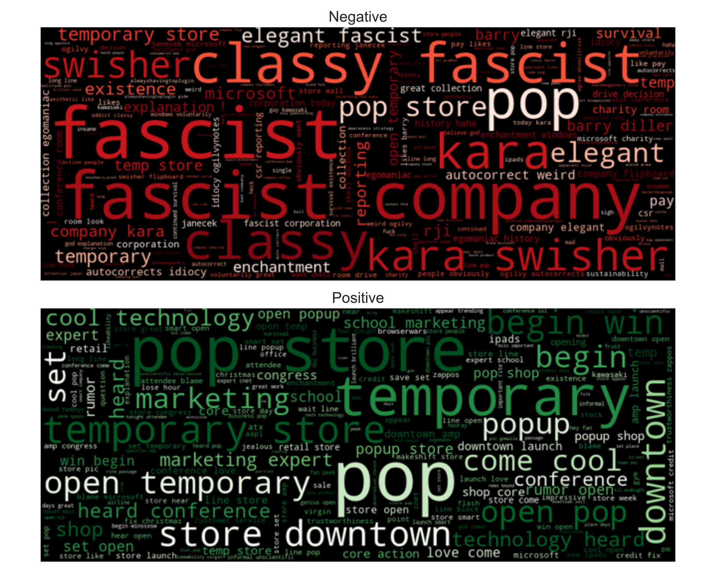
Freeeeedom! One of Apple’s values?
Recommendation:
Relinquish some control to send the message that people are free to use Apple’s products however they wish.
Apple is known for wanting total control of its products, even well after they leave the shelf.
The original comment was in response to the suggestion that Apple might create its own proprietary newsstand for e-magazines.
Flipboard: game-changer or just a fad? (2011)
At SXSW, Tech Reporter Kara Swisher called Apple “the classiest fascist company in America,” and it took off.
People were very excited about the “cool technology” at the pop-up store.

Slide 9
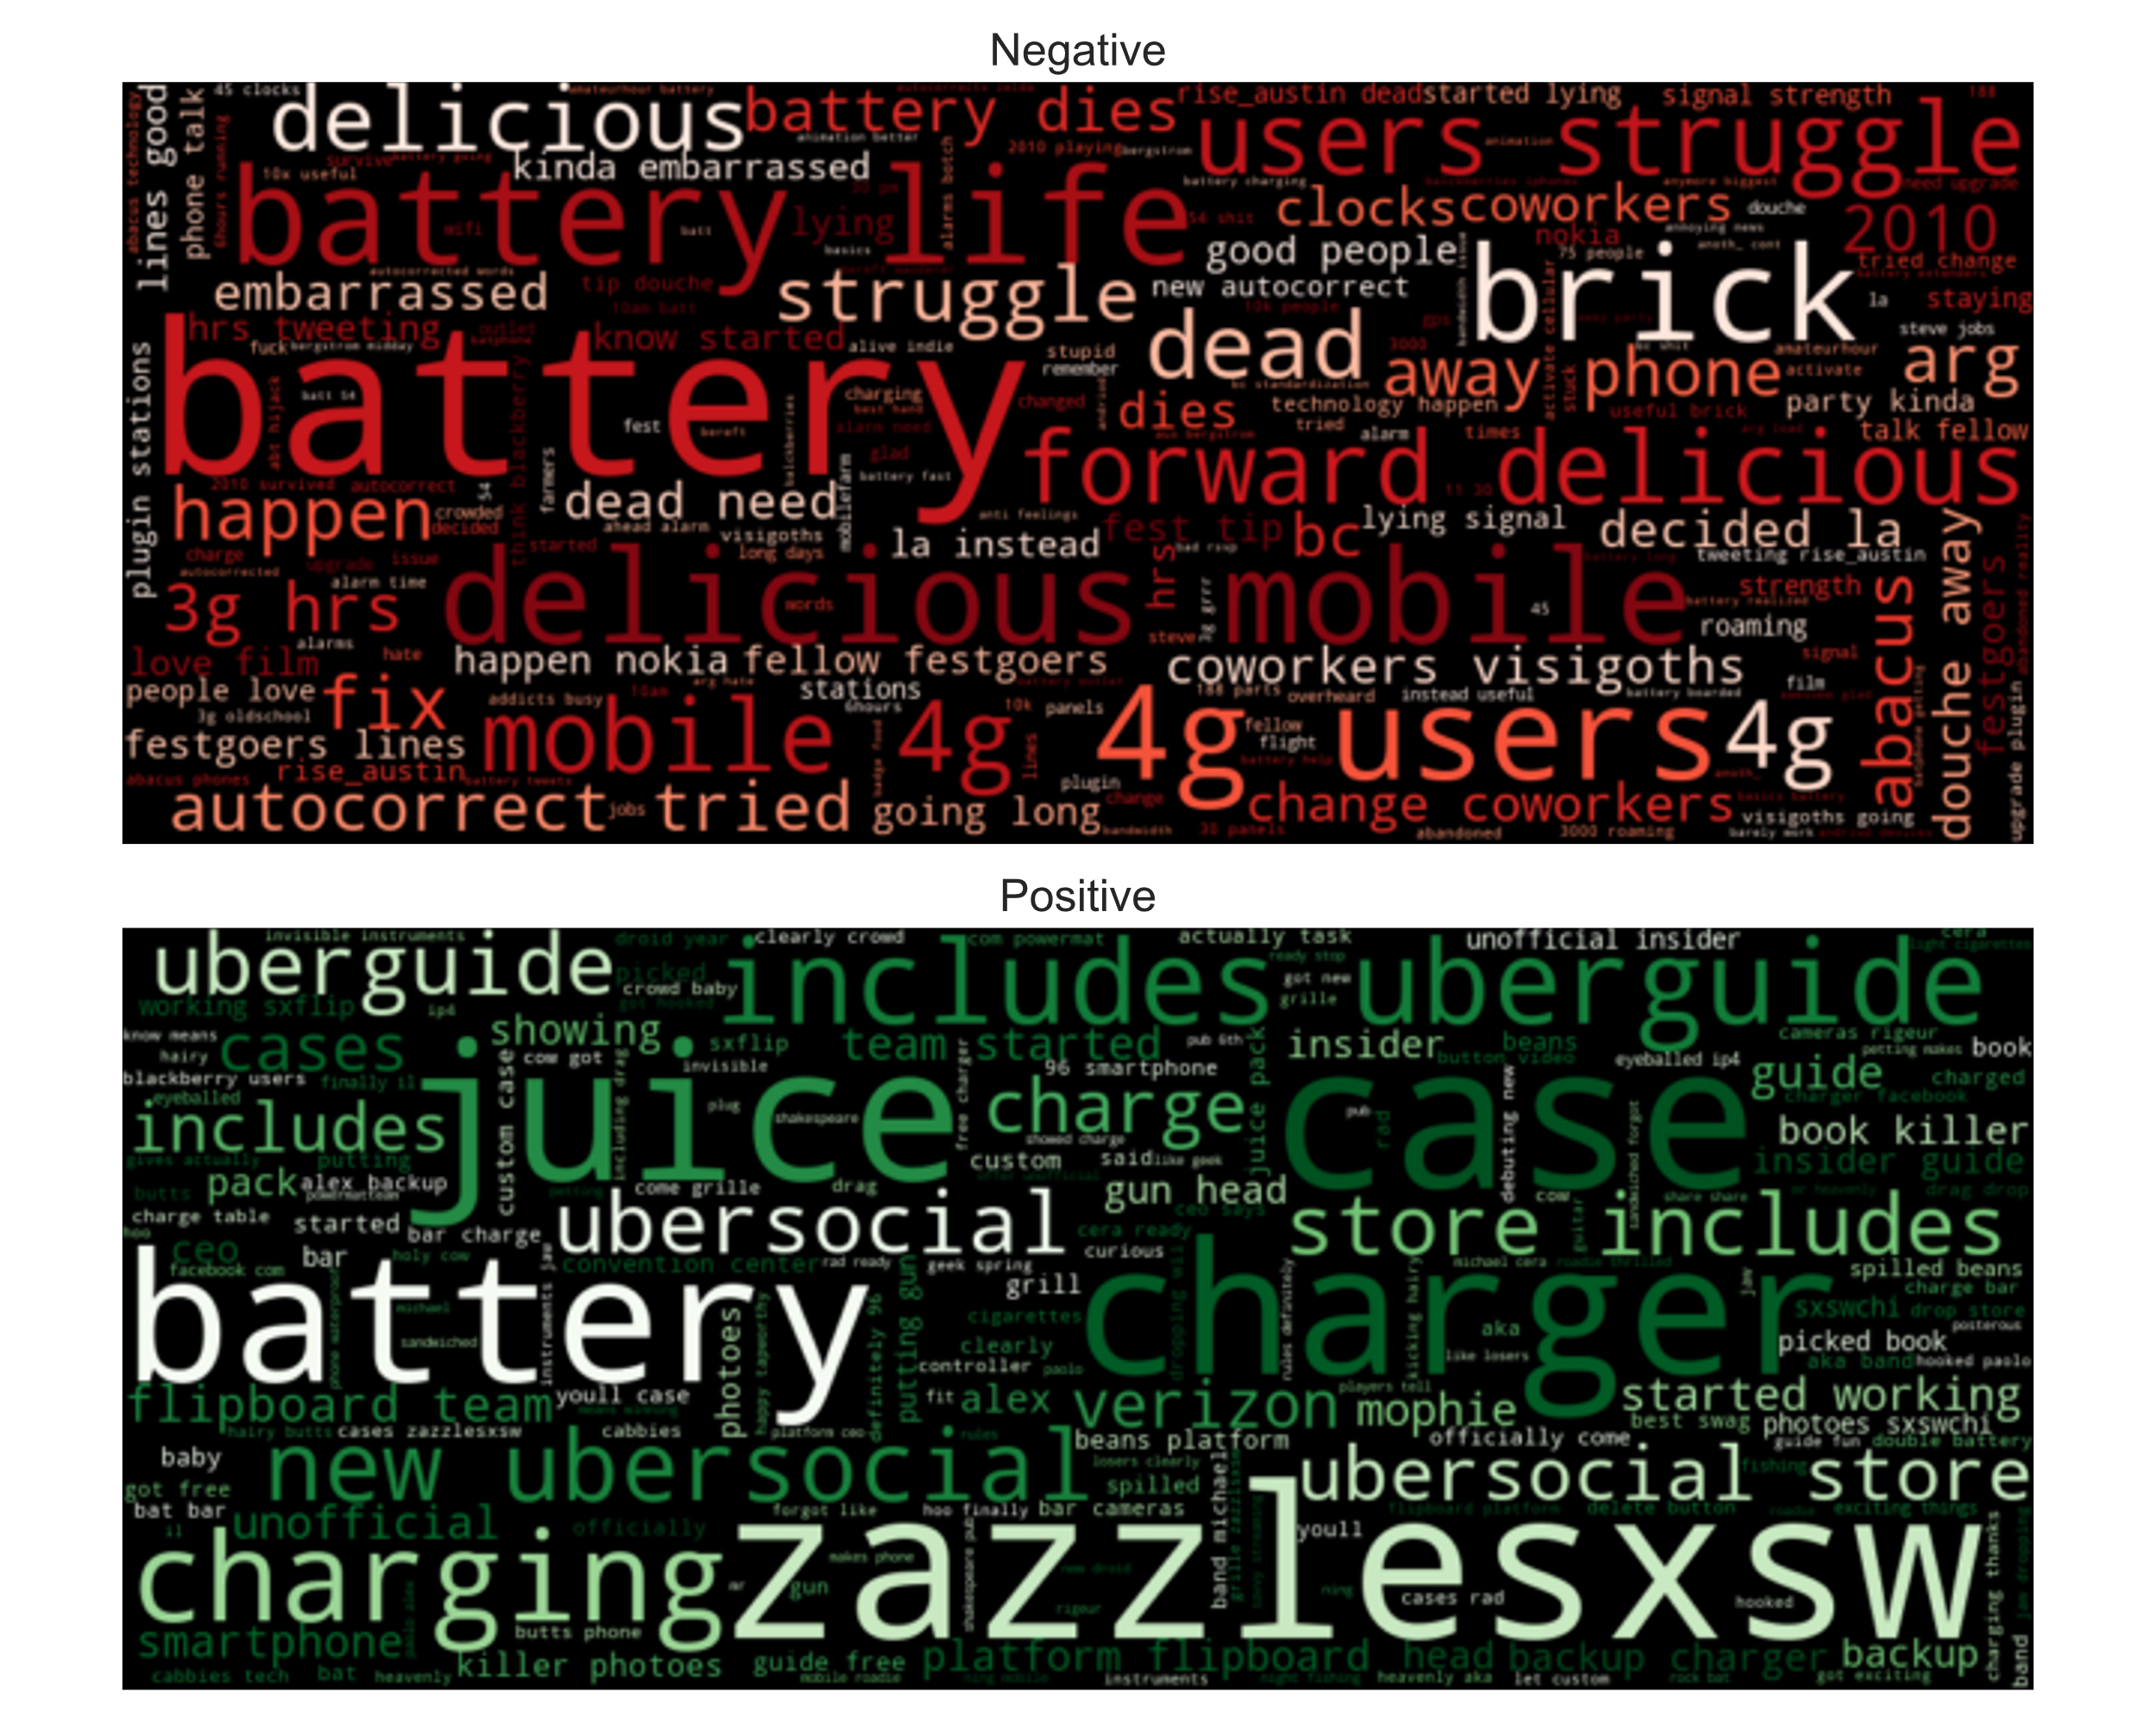
Complaints about iPhone Battery Life
Many people are complaining about the iPhone’s limited battery life.
Others are rejoicing at having a charger (see the positive word cloud).
Some people mocked the spotty AT&T service which many iPhone users have.
You already solved this problem by allowing Verizon to carry the iPhone.
Recommendation:
Improve the iPhone’s battery life and turn it into a new marketing campaign. People will pay attention.

Slide 10
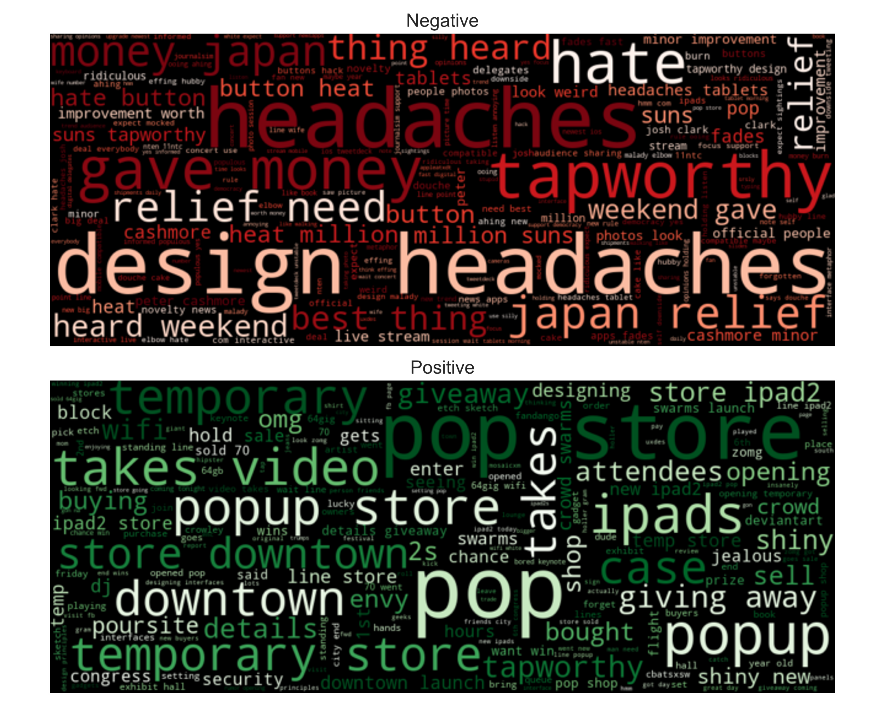
iPad 2 Popup Store was a Success
People couldn’t stop talking about the iPad 2 popup store.
Terms like ‘shiny new’ and ‘jealous’ have high importance.
On the negative side, there was viral tweeting about donating one’s iPad 2 money to Japan relief.
‘design headaches’ had to do with a benign talk given about iPad app design.
Recommendation:
Do another temporary popup store for your next big product launch.

Slide 11

Conclusion
I built an accurate model (0.66 balanced accuracy) despite the small and noisy dataset.
There is still room to improve the model.
I arrived at three recommendations:
Send the message that Apple cares about individual freedom by relinquishing control in a public manner.
Improve the iPhone’s battery life and use it as a rallying point for a marketing campaign.
Open another temporary popup store for your next big product launch.

Slide 12

Future Work
Stacking Classifiers
Combine the results of multiple classifiers.
Increases accuracy and both positive and negative recall.
Sophisticated Vectorization
Use a Doc2Vec model trained on a large corpus of tweets.
Explore other sophisticated vectorization algorithms.

Slide 13
Thanks
Nick Gigliotti
ndgigliotti@gmail.com

